Slide 1

Make Peace a Priority
A National Campaign Initiated by
Building on decades of advocacy, IPAN provides the national coordination, credibility, and network foundation for this unified campaign.
Notes:
That foundation is the Independent and Peaceful Australia Network. IPAN is the engine room for this national campaign, providing the credibility and network we need.
For decades, IPAN has been the consistent voice for peace and independence in this country. We are leveraging that deep history and national coordination to unify the broader movement.
This campaign is not a new organization; it is a unified effort built on IPAN's decades of advocacy. This strong foundation allows us to articulate a clear and compelling vision for the future.

Slide 2

Make Peace a Priority
Choose Diplomacy Over Destruction
Transform Australia's approach to international relations by institutionalising peace as the central organising principle of our foreign policy.
“
Peace is not merely the absence of war, but the presence of justice, cooperation, and security for all nations.
Notes:
Our vision is simple and powerful: Choose Diplomacy Over Destruction.
We aim to transform Australia's approach to international relations by institutionalizing peace as the central organizing principle of our foreign policy. Peace is not just the absence of conflict; it is the active presence of justice, cooperation, and security for all nations.
This is a fundamental shift in mindset, moving from a reactive, militarized posture to a proactive, diplomatic one.

Slide 3

The Challenge of Fragmentation
"There is probably more than a million people all working towards peace - but they are all in silos."
— Joe Camilleri
Notes:
We know the peace movement is vast and dedicated, but it is also fragmented.
Joe Camilleri's quote perfectly captures our challenge: "There is probably more than a million people all working towards peace—but they are all in silos.“
This fragmentation dilutes our collective power and makes it easy for decision-makers to ignore us.
IPANs Make Peace a Priority campaign is designed to be the unifying force that breaks down these silos. We are not creating a new organization; we are providing a common lens and a shared, tangible goal that should be the focus of our leaders.
This unified approach is essential if we want to move from advocacy to actual policy change. But unity is not just about bringing groups together; it is about strengthening the relationships between them.

Slide 4

From Vision to Action
The 125th Anniversary:
A Vehicle for Unity
Saturday
9 May
2026
This campaign provides a concrete vehicle for all peace and environmental groups to unite under an overarching umbrella – focusing on a single, historic moment.
125 Years Since Federation
Notes:
The 125th Anniversary of the Australian Parliament is not just a date; it is the perfect vehicle for unity.
This campaign provides a single, overarching umbrella under which all peace, environmental, and social justice groups can converge.
It is the practical opportunity, mobilizing diverse movements toward a single, historic moment on May 9, 2026 - a clear, non-partisan, and nationally significant focus point.
By centering our efforts on this anniversary, we gain legitimacy and a powerful platform to demand a re-evaluation of Australia's foreign policy.
This date is historically significant:

Slide 5

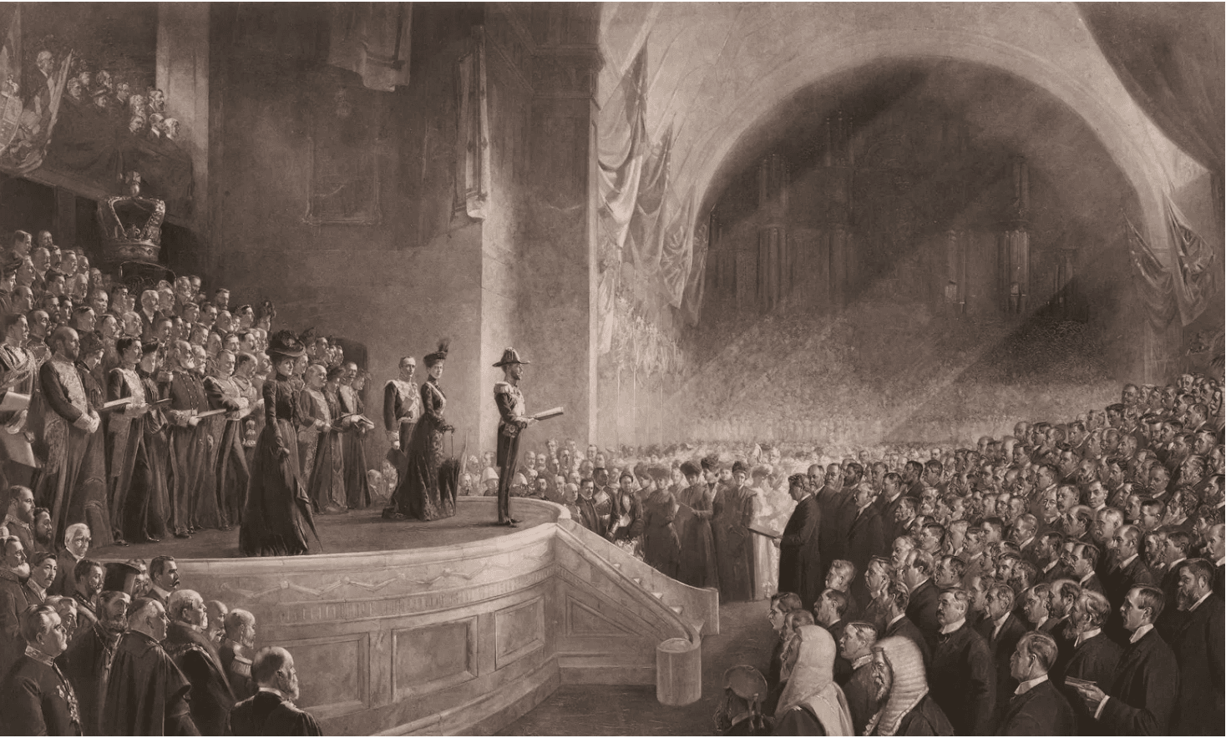
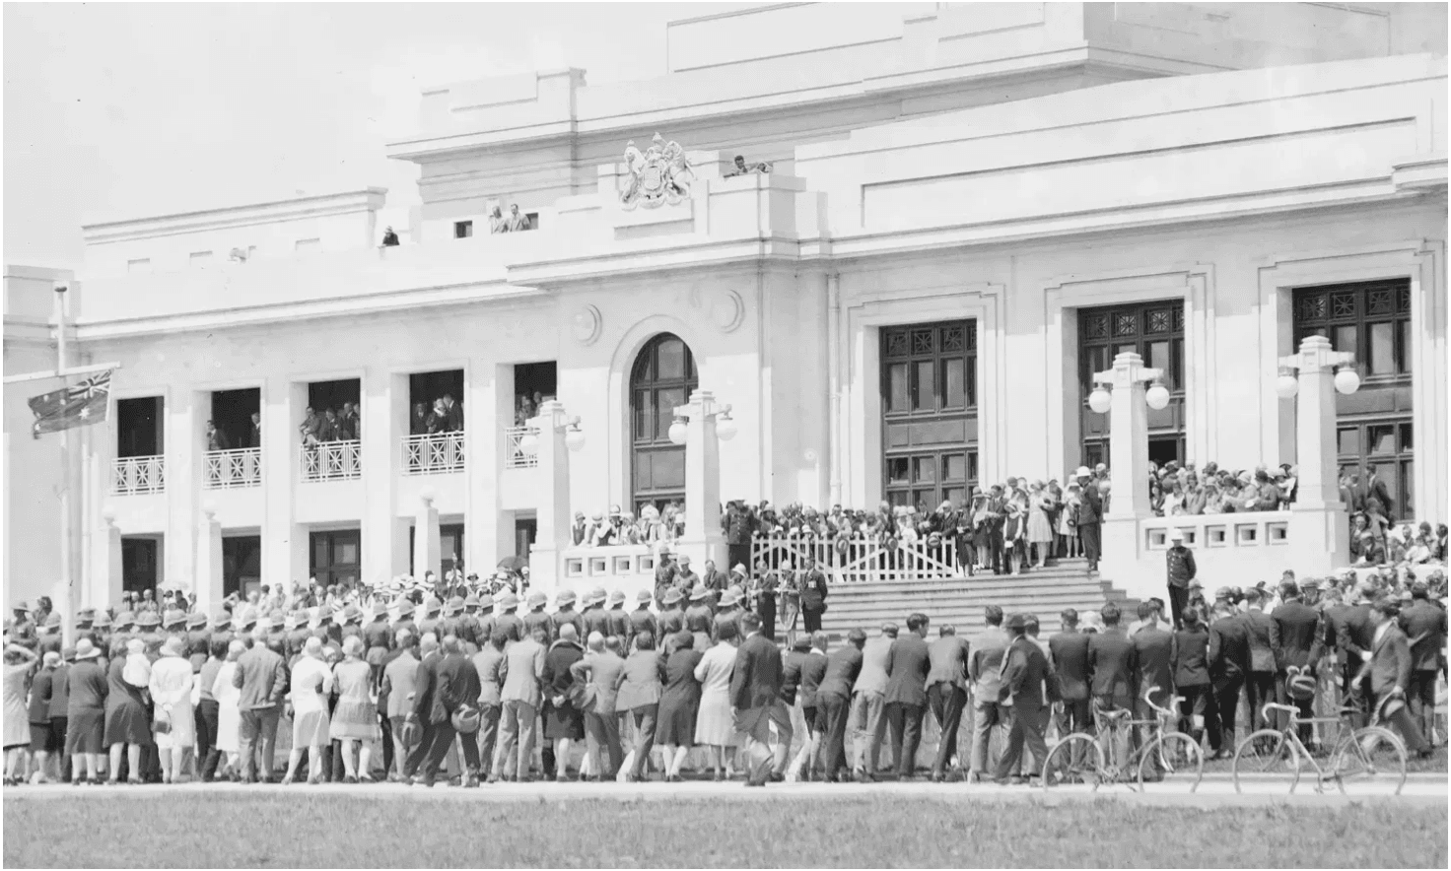
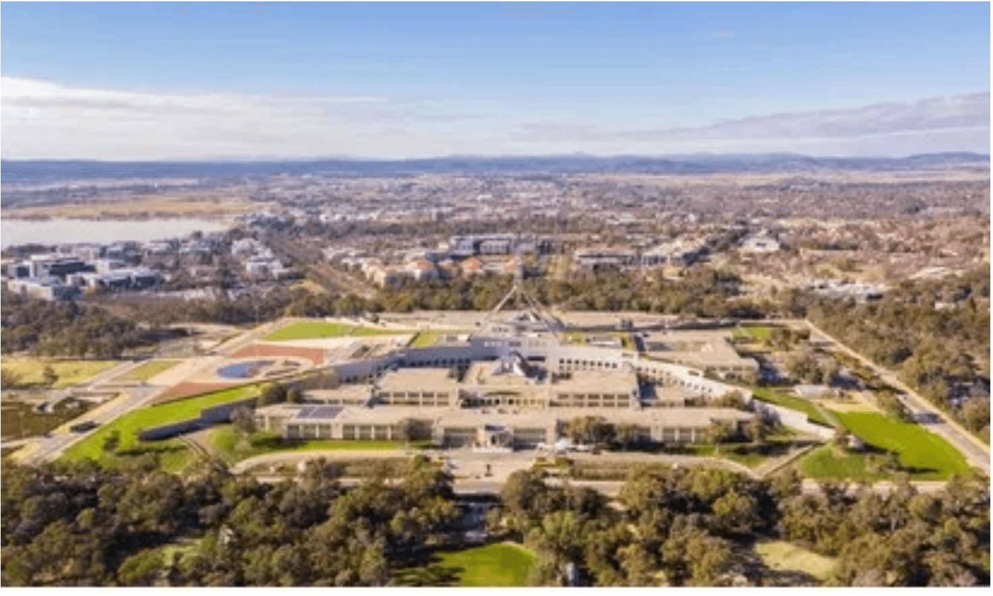
Historical Significance
9 May 1901
9 May 1927
9 May 1988
First Parliament Opens
Parliament Moves to Canberra
Current Parliament House
Australia's first federal parliament met in the Exhibition Building in Melbourne, marking the birth of our democracy.
The new parliament house was opened in Canberra, establishing the national capital as the seat of government.
The new and permanent parliament house was opened on Capital Hill, symbolizing modern Australian democracy.
Notes:
The date May 9th is etched into the history of Australian democracy, marking three major milestones in the life of our parliament.
We started in 1901 in Melbourne, a moment that officially brought our states together as a federation.
Then in 1927, we moved to Canberra, establishing our national capital and cementing the seat of government.
And finally, in 1988, the current Parliament House opened its doors on Capital Hill, symbolizing our modern, mature democracy.
We see a clear pattern here defining our nationhood. But we can't just celebrate the past; we must use this history to challenge the present.
This 125th anniversary is our chance to complete the unfinished business of genuine independence. So why does this anniversary matter so much right now?

Slide 6

Why the 125th Anniversary Matters
This anniversary provides a unique opportunity to reflect on what true independence means for Australia
01
02
Historical Legitimacy
Democratic Accountability
The anniversary gives us a platform to ask: Has Australia achieved genuine independence when foreign military bases operate on our soil?
125 years of parliament, yet major military commitments like AUKUS bypass meaningful parliamentary debate and public consultation.
03
04
Strategic Timing
Unfinished Business
The campaign culminates at the ALP National Conference in July 2026, where the party's National Platform for the next three years will be debated.
True independence requires Treaty with First Nations peoples and a foreign policy that serves Australian interests, not those of foreign powers.
Notes:
This 125th anniversary is not just a historical date; it is a strategic vehicle to redefine Australia's future. We use this historical legitimacy to ask a fundamental question:
Can we truly call ourselves independent when foreign military bases operate on our soil?
The anniversary also demands democratic accountability.
After 125 years, major commitments like AUKUS still bypass meaningful parliamentary debate and public consultation.
Critically, the timing is perfect. Our campaign culminates at the ALP National Conference in July 2026, giving us a clear, strategic window to influence the Labor Party's platform for the next three years. This is about seizing the moment to push for a foreign policy that serves Australian interests, not those of foreign powers. This strategic opportunity is vital because we face a profound crisis of sovereignty.

Slide 7

National Campaign Framework
A coordinated national approach with tailored themes for each major city, unified by our core demands for independence and peace.
Melbourne
Canberra
Historical Hub
Parliamentary Focus
Brisbane
Perth
Pacific Peace
Nuclear-Free West
Sydney
Adelaide
Media Capital
Community Power
Darwin
Hobart
Anti-Base Action
Island of Peace
Notes:
We need a coordinated, national campaign framework to deliver on our vision.
We aren't running one campaign; we are coordinating tailored campaigns across every major city, unified by our core demands.
This map shows how we are maximizing our impact by focusing on local strengths. Darwin focuses on anti-base action, Canberra on parliamentary pressure, and Sydney on media outreach.
This strategic coordination ensures we speak with one voice on the national stage while resonating deeply with local communities.
We must break down the silos between our own peace groups to create a single, powerful movement. This national coordination is essential to building the political pressure we need.
So, what does the timeline for this coordinated effort look like?

Slide 8

Campaign Timeline to 125th Anniversary
Jan 2026
Resource Development & MP Briefings
Developing materials and conducting initial briefings with Ministers and MPs.
Mar 2026
High-Level Political Delegation
Delegation to Canberra to present the MPAP policy framework.
May 9
National Anniversary Events
Coordinated events in 8 major cities marking the 125th Anniversary.
Jul 23-25
ALP National Conference (Adelaide)
The campaign culminates here, where the party's National Platform for the next three years will be debated and agreed. This is a strategic opportunity to influence Labor Party policy on peace and independence issues.
Notes:
This timeline shows the path to our strategic goal: the ALP National Conference in July 2026.
The 125th anniversary on May 9th is our massive public launch, a moment to galvanize support nationwide.
We are using the months leading up to May 9th for resource development and political briefings.
The anniversary itself can be a coordinated national event, a massive show of public support.
But the real policy leverage comes at the ALP Conference in Adelaide. This is where the party platform is set for the next three years.
We must use the momentum we generate to ensure our demands are on the agenda. We are using this window to influence the future direction of the governing party. To do that, we need concrete policy proposals ready to go.

Slide 9

Initial Proposals to Government
01
Expand Minister for International Development Role
Integrate peacebuilding responsibilities within the existing ministerial portfolio to ensure a dedicated focus on conflict prevention and resolution.
02
Consolidate All Areas Working on Peace
Ensure peace is given appropriate focus across government departments and agencies, breaking down silos to create a unified approach to security.
03
Increase Resourcing for Conflict Prevention
Provide additional funding for research bodies, increase resources for Australia's role on the Peacebuilding Commission, and expand diplomacy to pursue a peace agenda in the Indo-Pacific.
Notes:
We aren't just making noise; we are offering achievable, concrete proposals to the government right now.
These initial asks focus on structural and symbolic change to institutionalize peace within government.
First, we must expand the Minister for International Development's role to include peacebuilding. This signals a clear commitment to conflict prevention.
Second, we need to consolidate all peace-related areas across government departments. This breaks down silos and ensures peace gets the appropriate focus and resources.
Finally, we must increase resourcing for conflict prevention research and diplomacy, especially in the Indo-Pacific. These are practical steps the government can take immediately to make peace a priority. Now, let's look at the broader policy framework that underpins these proposals.

Slide 10

Coalition Building Strategy
Our aim is to build irresistible political pressure by uniting diverse sectors around shared interests and common threats.
Trade Unions
Connecting peace with workers' rights, job security, and economic conversion.
Environmental Groups
Highlighting the military's massive carbon bootprint and resource drain.
Faith & Community
Mobilizing around ethical imperatives and humanitarian concerns.
First Nations
Centering sovereignty and land rights as the foundation of genuine peace.
Uniting against the devastating environmental and human costs of militarism.
Notes:
To make this policy framework a reality, we need irresistible political pressure, and that requires a robust Coalition Building Strategy.
We are uniting diverse sectors around shared interests and common threats.
Trade Unions by showing how peace links directly to workers' rights and better jobs through economic conversion.
Environmental Groups by highlighting the military's massive carbon bootprint and resource drain.
And First Nations voices, recognizing that genuine sovereignty and peace must start with Indigenous rights.
We are uniting against the devastating environmental and human costs of militarism.

Slide 11

Environmental Security
The Military Carbon Bootprint
Global militaries are the world's largest institutional consumers of oil. War accelerates climate breakdown, destroying ecosystems and diverting critical resources.
The AUKUS Opportunity Cost
$368 billion spent on nuclear submarines is money stolen from the renewable energy revolution. We must choose: an arms race or a livable planet.
True Security is Climate Action
The greatest threat to Australia is not a foreign power, but the climate crisis. Security means funding disaster resilience, not foreign wars.
Notes:
We have Friends Of The Earth on board - True Security is Climate Action, and the military carbon bootprint is a massive, often-ignored threat.
Global militaries are the world's largest institutional consumers of oil, and war accelerates climate breakdown, destroying ecosystems and diverting critical resources.
The AUKUS Opportunity Cost is stark: $368 billion spent on nuclear submarines is money stolen from the renewable energy revolution.
We have a clear choice: an arms race or a livable planet.
The greatest threat to Australia is not a foreign power; it is the climate crisis itself. Security means funding disaster resilience and climate action, not foreign wars.
Our proposals integrate peace and resource reallocation because you cannot have environmental security without peace. Now, let's look at how we measure the impact of this ambitious campaign.

Slide 12


Peace is Our Priority
$368B
Wasted on AUKUS Submarines
We Choose To Invest In:
Public Healthcare & Pandemic Preparedness
Free Education from Early Childhood to TAFE
Urgent Climate Action & Renewable Energy
Affordable Housing for All Australians
An Independent Choice
Security comes from social well-being and environmental stability, not from fuelling a regional arms race.
Notes:
We are currently committing $368 billion to the AUKUS submarine deal, a massive expenditure that fuels regional tension.
We must redirect that money to genuine security that comes from social well-being and environmental stability.
Imagine what we could do if we invested that funding in public healthcare, free education, or urgent climate action and renewable energy.
Security doesn't come from fuelling an arms race; it comes from ensuring our citizens are healthy, educated, and housed. We must make an independent choice to prioritize resources for life, not for destruction. And that choice must be grounded in justice.

Slide 13
Strengthening Relationships
International Role
Systemic Change
Enhance Australia's role in international agencies working to achieve peace, providing a positive vision for the future.
Working for long-term systemic change within existing social and geopolitical frameworks provides a pathway to lasting peace.
Social Cohesion
De-escalation
Addressing historical conflicts and value differences is essential to promote social cohesion and partner for positive regional change.
Moving towards an independent Australian defence—rather than US-led offence—serves to de-escalate tensions regionally and globally.
Notes:
The goal of strengthening relationships extends far beyond just our internal movement.
We need to focus on four key areas to achieve systemic change.
First, we must enhance Australia's international role by actively participating in global peace agencies, offering a positive vision for the future.
Second, we must commit to long-term systemic change, working within existing frameworks to ensure lasting peace, not just temporary fixes.
Third, social cohesion is vital; we must address historical conflicts and value differences at home to be a credible partner abroad.
Finally, we must move towards an independent Australian defense posture, de-escalating regional tensions by shifting away from a US-led offensive strategy. This holistic approach to peace is what can truly unite our nation.

Slide 14
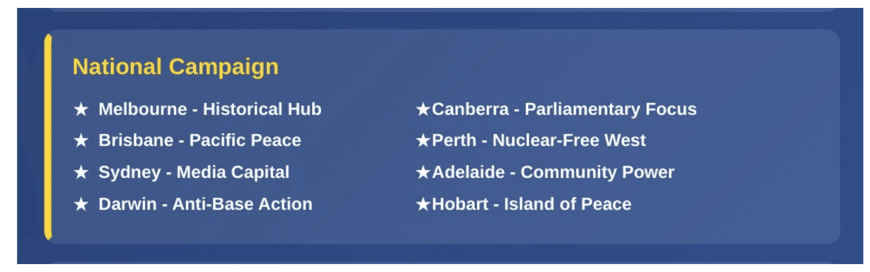
Take Action Today
1. Join the Campaign
Connect with your local IPAN group and help build the coalition in your community.
2. Contact Your MP
Demand parliamentary oversight for war powers and an independent review of AUKUS.
ipan.au
3. Mobilize for May 9
Organize and attend the 125th Anniversary events in your capital city.
Notes:
We've laid out the vision, and the strategy, and now it's time for every person to act.
The 125th anniversary of our Parliament is a unique, unrepeatable opportunity to change the course of Australian foreign policy.
First, Join the Campaign by connecting with your local IPAN group; we need boots on the ground building the coalition in every community.
Second, Contact Your MP and demand that Peace becomes a lens thought which all policy is evaluated
Third, and most importantly, Mobilize for May 9th, 2026. Organize and attend the anniversary events in your capital city to show the government that the public demands peace. Visit mpap.au today to get started.

Slide 15

Peace Can Unite Australia
A Vision All Australians Can Aspire To
Most Australians see peace as an objective worth striving for—they just need to know it is achievable.
Peace is many things to many people. By harnessing this inherent desire, we reinforce what unites rather than divides.
This proposal brings leaders from different backgrounds to a united approach to achieving peace.
"Peace as an objective helps unite our nation and our region."
Notes:
Peace is the single issue that can unite Australia because it is a vision all Australians can aspire to.
Most people inherently see peace as a worthy objective; they just need to believe it is achievable and relevant to their lives.
By focusing on peace, we harness this inherent desire and reinforce what unites us rather than what divides us politically or socially.
This campaign brings leaders from diverse backgrounds—from unions to faith groups to environmentalists—into a united approach.
As the quote says, "Peace as an objective helps unite our nation and our region." This shared vision gives us the necessary foundation to launch a major, unifying campaign.

Slide 16
Building a Peaceful Future
The 125th Anniversary is our moment to reclaim our history
shape our future
Join the movement
Make Peace a Priority
Notes:
This campaign is about more than just policy; it's about reclaiming our history and shaping a truly independent future for Australia.
The 125th Anniversary gives us the perfect platform to demand that our government makes peace a priority. We have the chance to redirect billions from destruction to life, to assert genuine sovereignty, and to build a nation that leads with diplomacy, not militarism.
Support this step towards an Independent and Peaceful Australia.
Let's build a peaceful future together.
Thank you.

